Slide 1
Positive Psychology

Slide 2
Definition of Positive Psychology
Martin Seligman:
‘Scientific study of optimal human functioning [that] aims to discover and promote the factors that allow individuals and communities to thrive'.

Slide 3
Some fascinating studies
Give the doc a lollipop
Jelly at lunch
Random acts of kindness
The exam conundrum
Exercise

Slide 4
Happiness ------------------- > Success

Slide 5
How our brains work – “selective attention”
Selectively attend to that which supports what we believe / expect and selectively ignore what we don’t believe / expect
What we selectively attend to expands in size and frequency and weight over time
What we selectively attend to we physically orientate towards EVEN when trying to avoid it

Slide 6
How our brains work
Humans are pre-programmed to perceive continuity for predictive reasons
  Eg?
The above is maintained through selective attention
  Eg?
Over-focusing on problems creates a perception of no change and can disempower the consultee
  Eg?

Slide 7
Three Good Things
Turn to the person next to you and tell them three good things that have happened in the last 24 hours. They could be of relatively small or large importance. Try to think of one thing that you have managed to actually do/achieve (beyond just good luck!)
Listeners can prompt further reflection:
Why did this good thing happen?
What does this mean to you?
How can you increase the likelihood of having more of this good thing in the future?

Slide 8
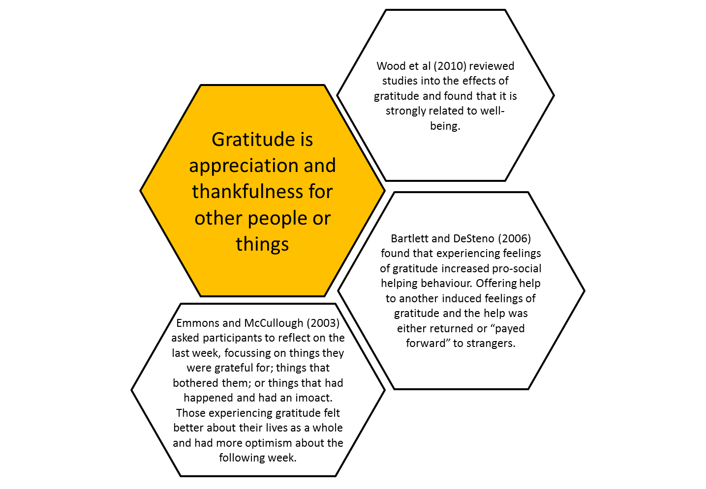
Effects of gratitude

Slide 9
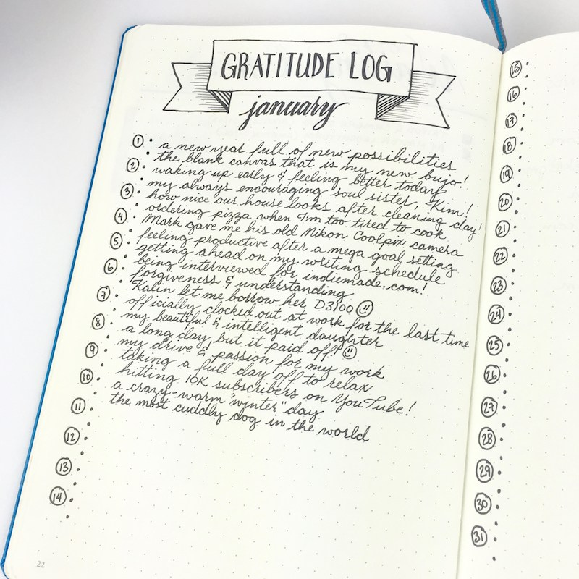
Gratitude logs
Note down two things that you are thankful for today.
Notes:
Focus on things that have happened in school each day.
Improves sense of school belonging, pro-social behaviours, protects against stress and promotes optimism and life satisfaction.
“write down two or three things that you are thankful or grateful for today at school”
10 minutes at the end of each day.
Children 7+ can do this

Slide 10
What is working well
Now think beyond the individual to your team:
Tell the person next to you something that you think is working well at work, it could be someone or something that helps you to do your job well, feel supported or positive about your work in some way.

Slide 11
Re-craft what you don’t like doing
What are your signature strengths?
How can you support young people to recognize and develop theirs?

